Slide 1
CAPSTONE PROJECT – UNLEASHING INSIGHTS FROM FOOTBALL DATA
NAME : SAHITHYA s

Slide 2
CONTENTS : FOCUS AREAS
1. Performance Analysis
2. Player Profile and Market Value
3. Team Comparison
4. Attendance and Stadium Analysis
5. Referee Analysis
6. Substitution Patterns
7. Event Analysis
8. Competition Analysis
9. Player Attributes and Demographics
10. Contract Management

Slide 3
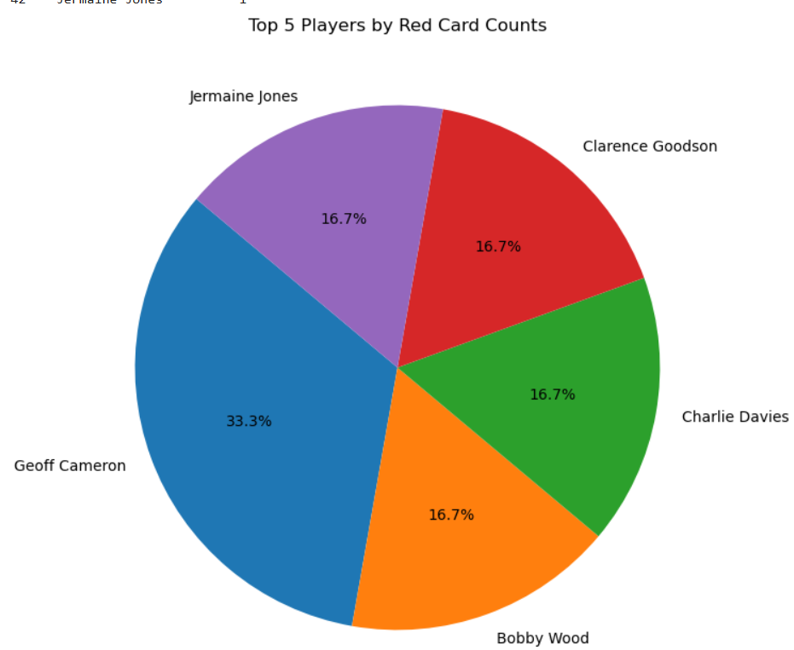
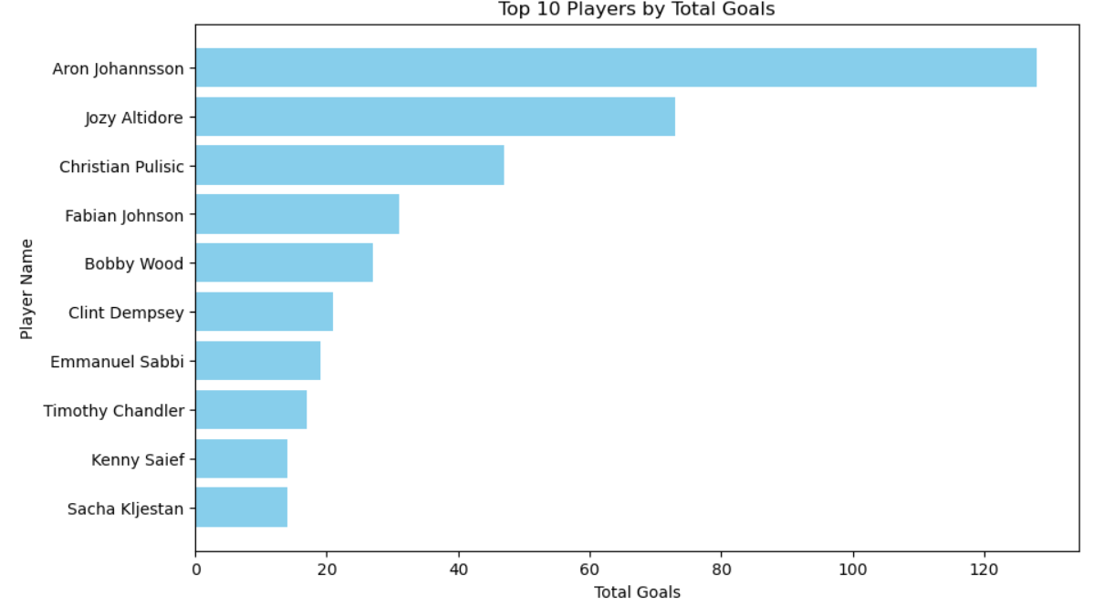
Performance Analysis
1) Top 5 PLAYERS BY RED CARD COUNT
This chart depicts the top 5 players having the more red card where, Geoff Cameron tops the list with 2 red cards with him
2) TOP 10 PLAYERS BY TOTAL GOALS
This chart depicts the top 10 players with highest number of total number of goals where Aron Johhansson tops the list with 128 goals.

Slide 4
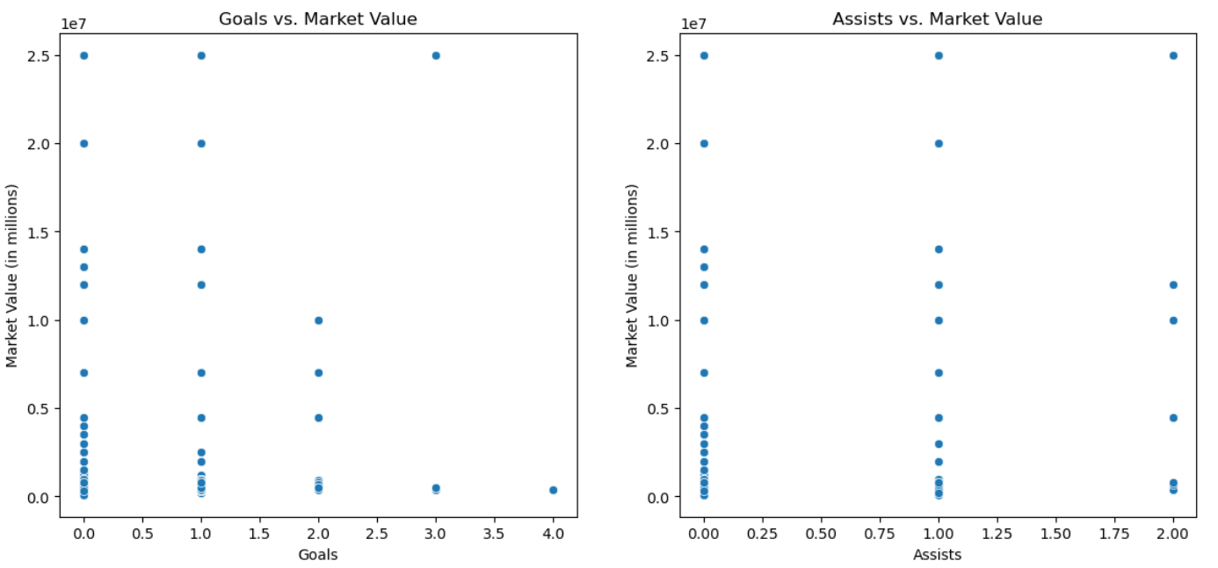
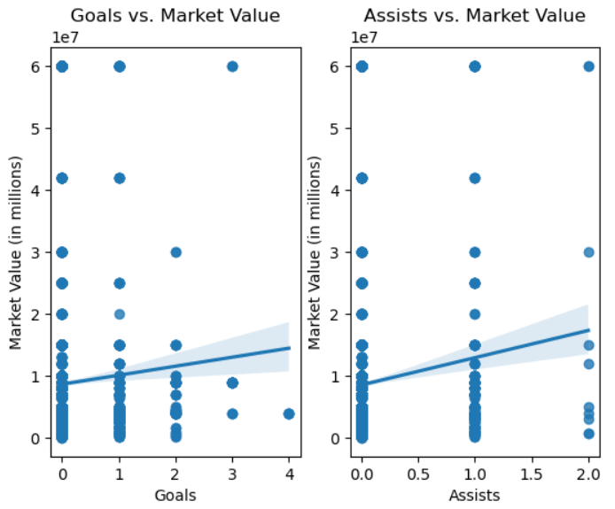
MARKET VALUE
1) How does key performance metrics( like goals, assists) influence the market value of player
Here goals 0, 1 and 2 have high market value which is evenly spread and comparitively 2, 3, 4 are not spread much and does not have , for the assistswe have the goals 0, 1, 2 where equally it is spread over a range for the market value.
2) how does metrics like goals , assists correlate with highest market value fluctuations
Here the metrics goals and assists correlation with the highest market value shows that then goals 0 and 1 are highly correlated with highest market value where as 4 is least and coming to assists all 3 values 0, 1, 2 are highly correlated with highest market value.

Slide 5
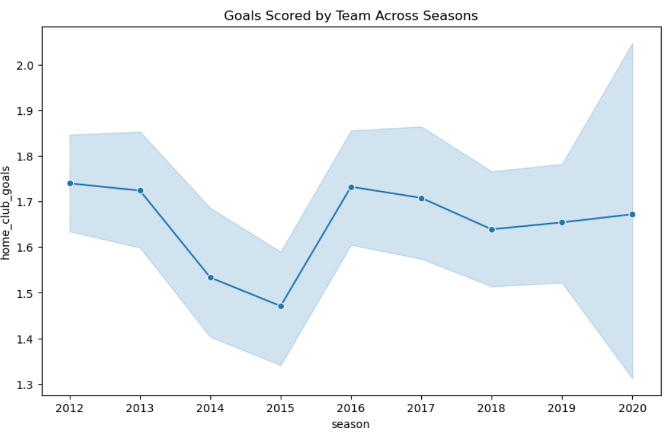
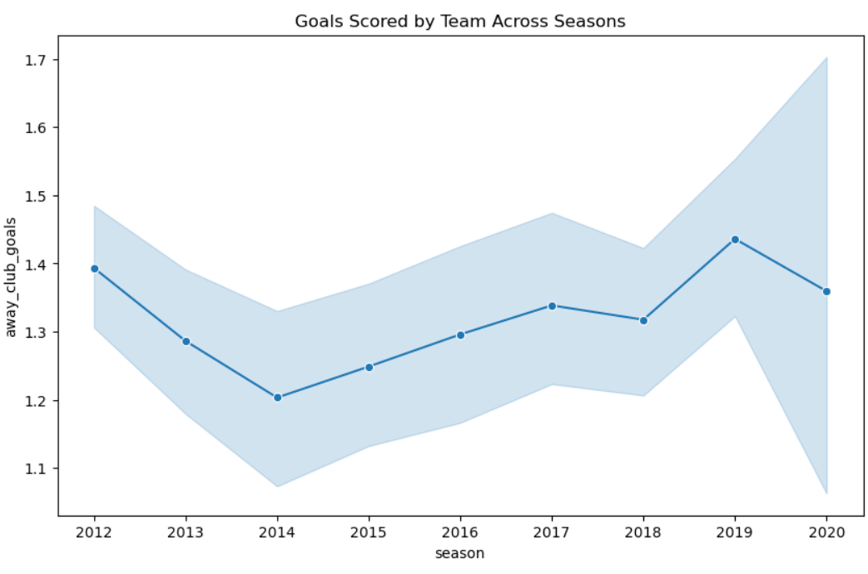
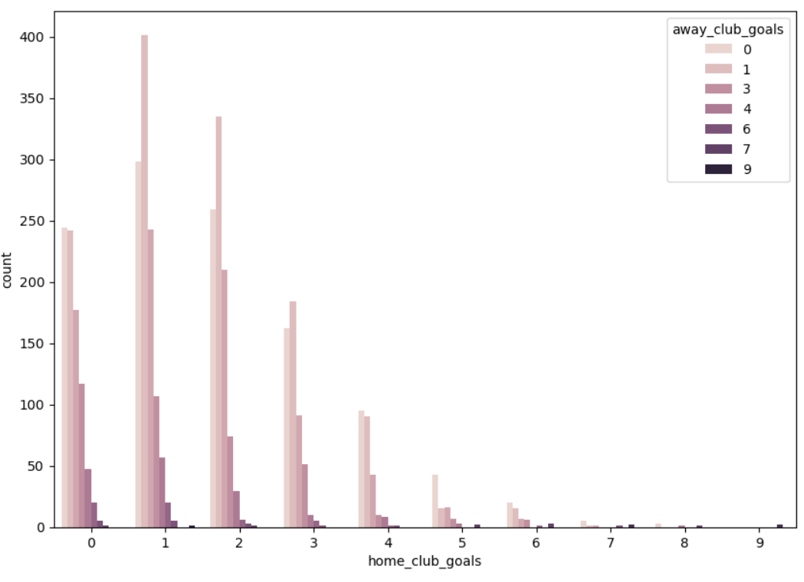
Team Comparison
1) how does overall performance of both teams in terms of goals scored in past seasons
Here overall performance by home club team is represented using line chart in terms of goals scored in past seasons , so coming to the home vlub goalsit is seen that in the year 2012 is the high goal hit and in 2015 there is a gradual dip in the hit of the goal.
2) Team comparison based on goals for both the teams
IAbove representation shows the count of goals of both the team goals namely home club goals and away club goals , in home club team it is seen that 1 and 2 are the goals hit more comparitively to other goals and in away clun team 1 goal was hit prominently lot more times.

Slide 6
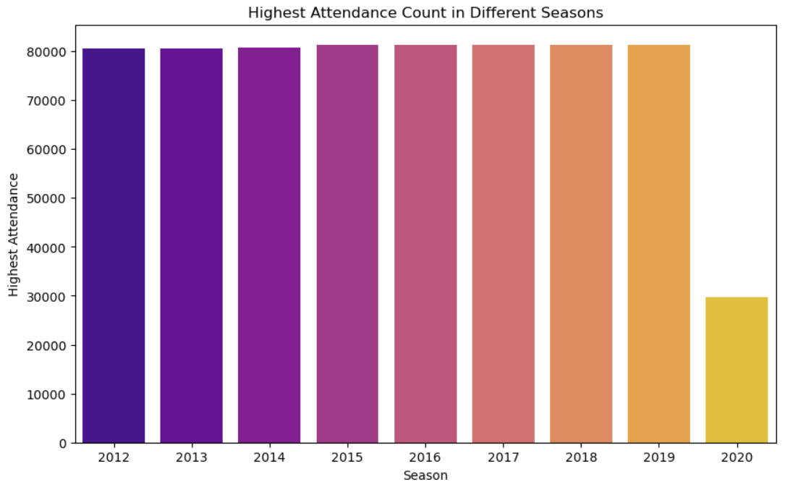
Attendance and Stadium Analysis
1) attendance based on the positions of the home club team and away club team
Attendance by the home club based on their positions in the matches and the attendance followed by it is seen above so when their position was no.1 it is seen that they has a lot of people attending the match and for away club their attendance peaked up when their position was no.17
2) find out the highest attendance count of a football match in different seasons
It is seen that from 2012 - 2019 the attendance was constant throughout consecutively with almost 80,000 counts of people and there is a decline with 30,000 count only in the year 2020.

Slide 7
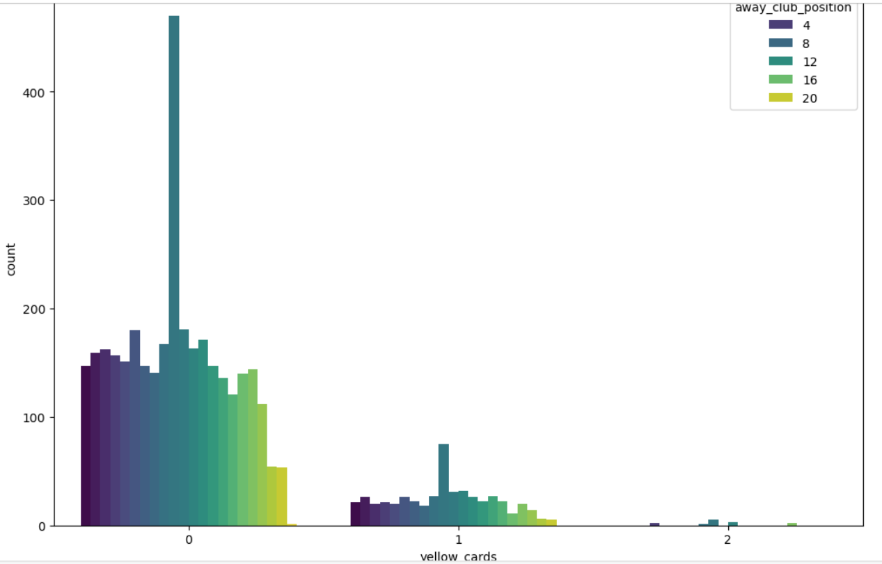
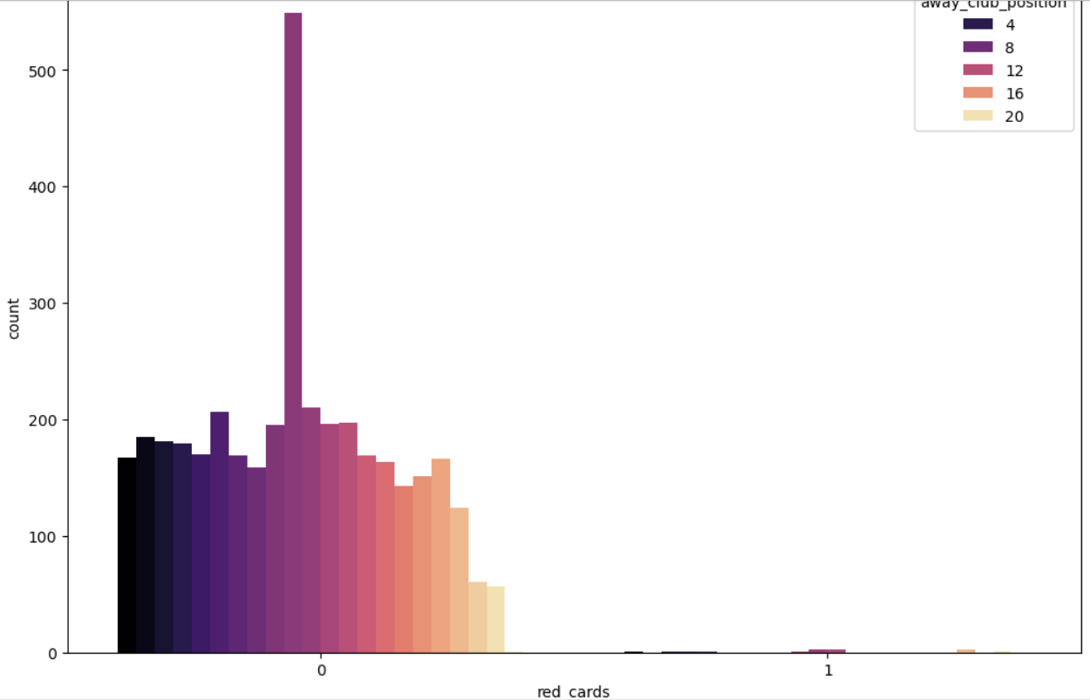
Referee Analysis
1) how the decisions made by referees like red cards yellow cards impact the overall outcome of matches for home club
Match outcome based on yellow card and red card is shown above for home club team , it is seen that home club position with the position number 8is the highest for the number of yellow cards 0, 1 and 2 and for red cards again it is the 8th position but only for the 0 number of red cards
2) how the decisions made by referees like red cards yellow cards impact the overall outcome of matches for home club
the yellow cards 0, 1 and 2 it is the 8th position highest one and the same for red card.

Slide 8
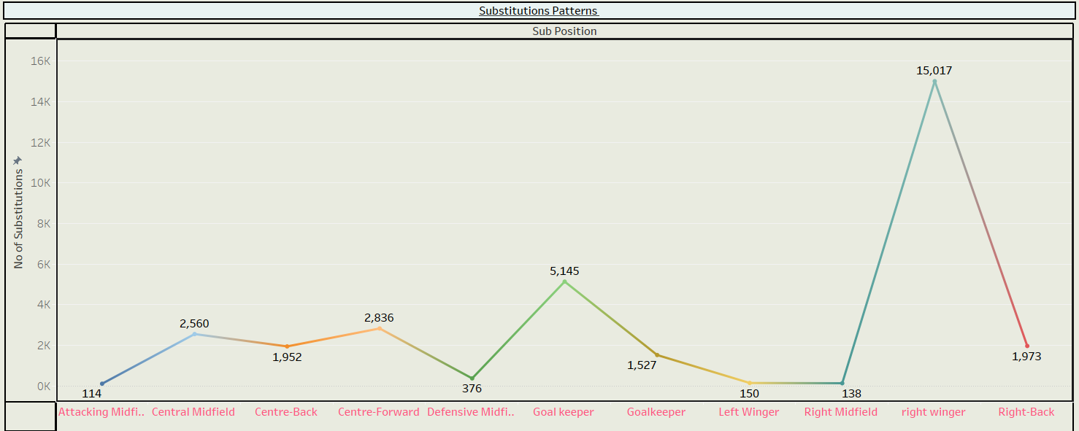
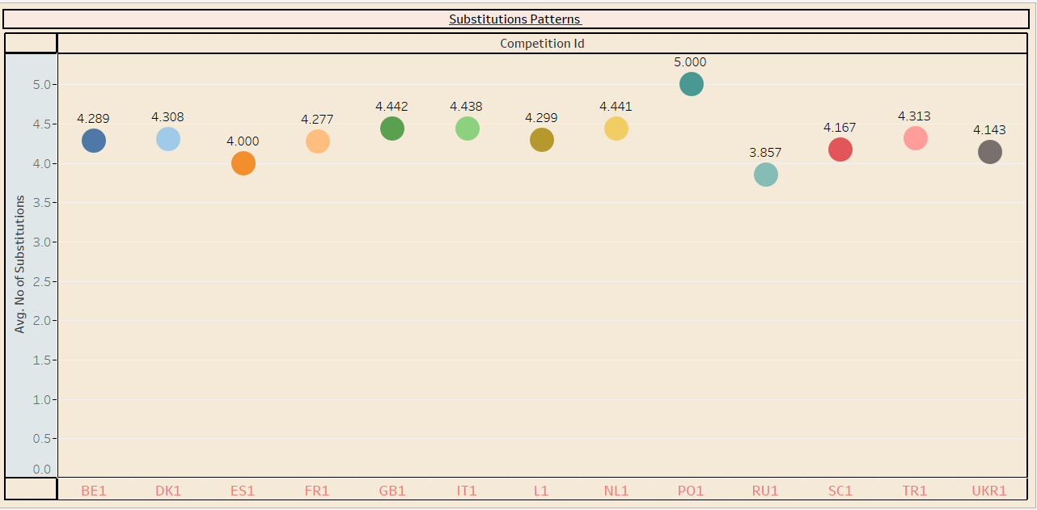
Substitution Patterns
1) Which position of players is substituted the most frequently?
The line chart provides a clear visualization of which player positions are substituted most frequently. This information can be crucial for understanding managerial tactics, player performance management, and how teams adapt during a game
2) How does the average number of substitutions per game vary across different competitions?
The circle chart reveals how the average number of substitutions per game varies across different competitions, with larger circles indicating competitions where teams make more frequent substitutions.

Slide 9
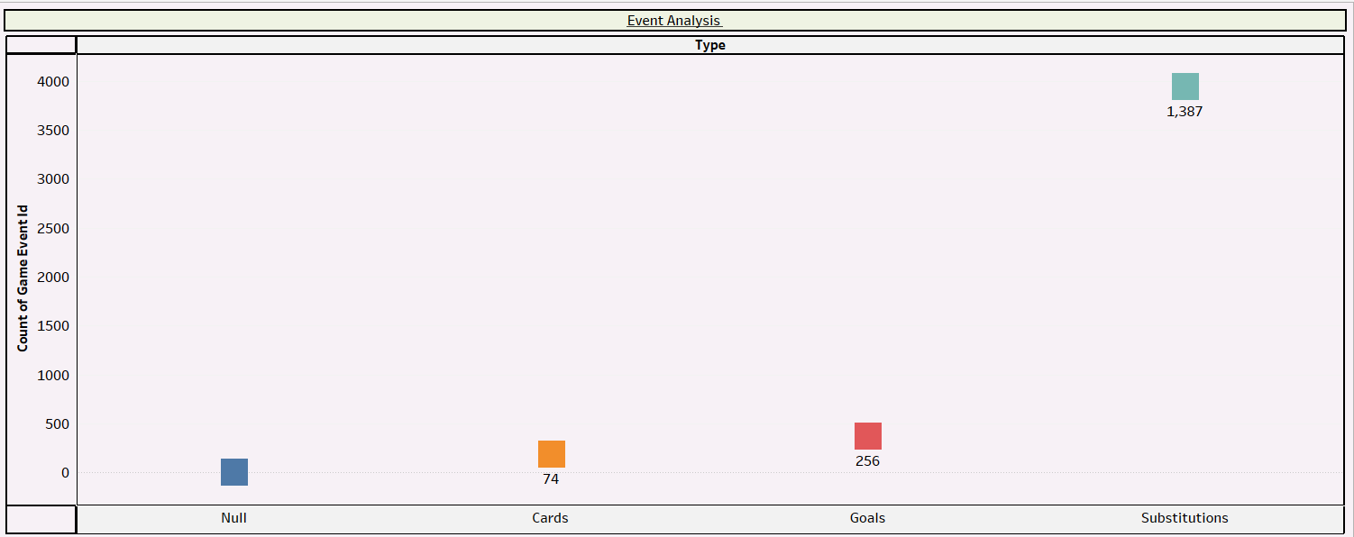
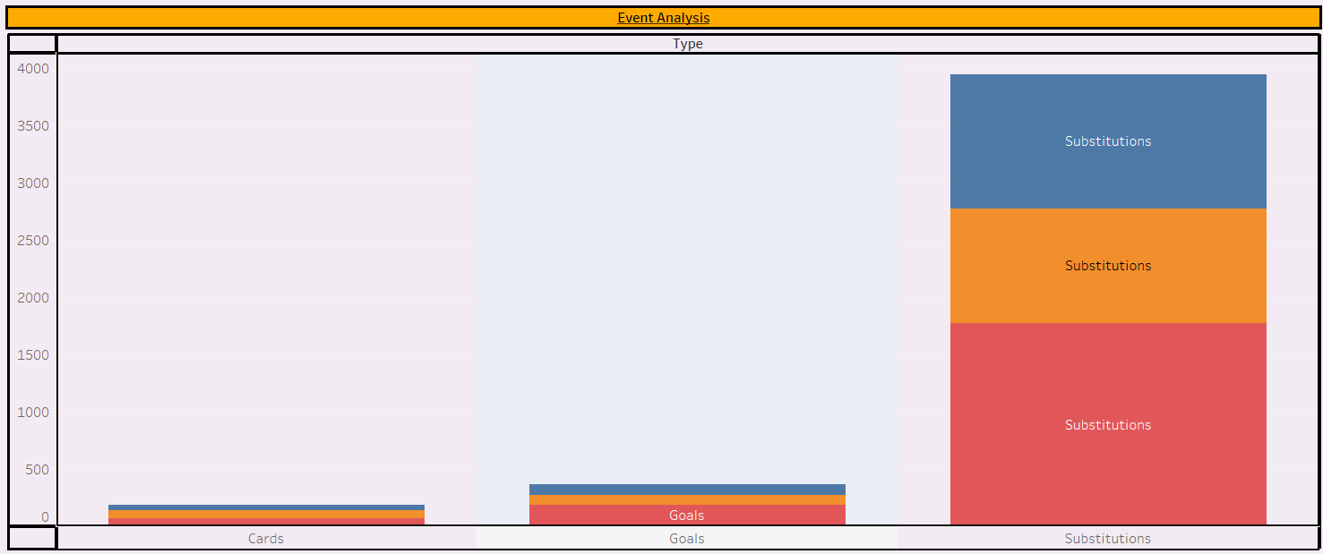
Event Analysis
What are the patterns and impacts of different types of game events on the outcome of matches?
The analysis of game events and their impact on match outcomes reveals several key insights. By examining the frequency and effects of different types of game events—such as substitutions, yellow cards, red cards, and assists—we can uncover significant patterns in how these events influence match results
What is the impact of game events on the final match result?
The chart will show the distribution of match results based on the types of game events, helping you analyze the impact of those events on the final outcome of the matches. The visualization provides actionable insights into how specific game events, such as goals, red cards, and substitutions, influence match results. The strongest indicators (like goals) show a clear relationship with either Home Wins or Away Wins, while more nuanced events (like substitutions) could reveal tactical patterns used by managers to influence the outcome. Red cards could be particularly telling in determining how teams fare when playing with fewer players.

Slide 10
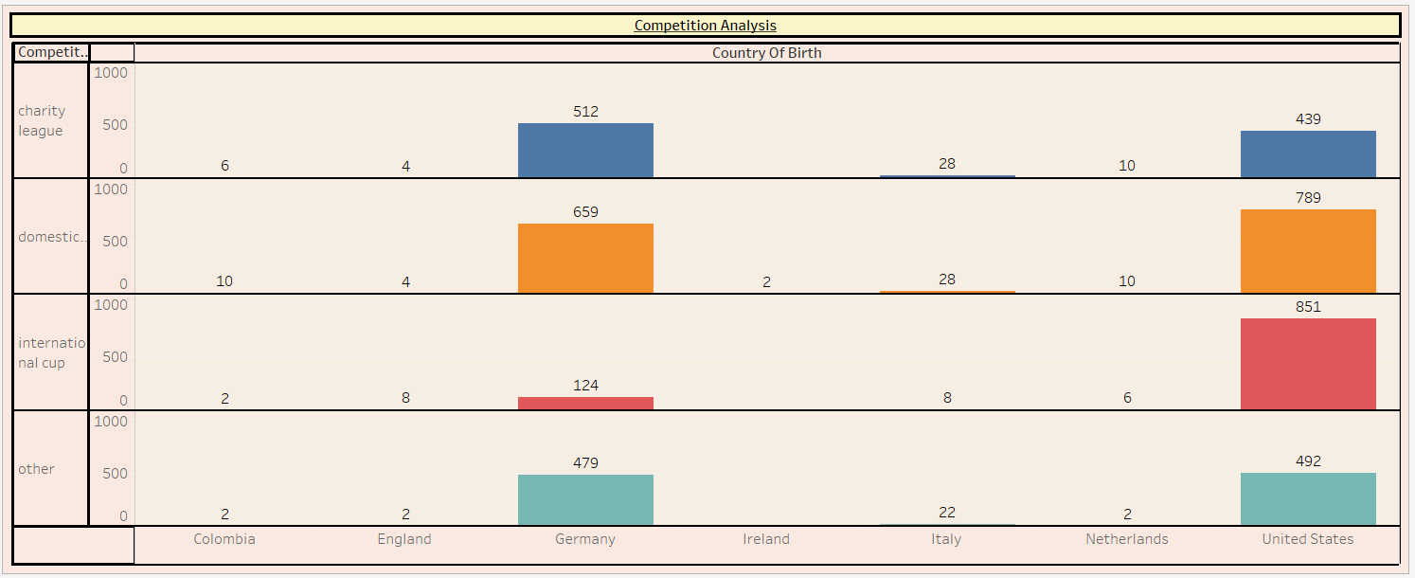
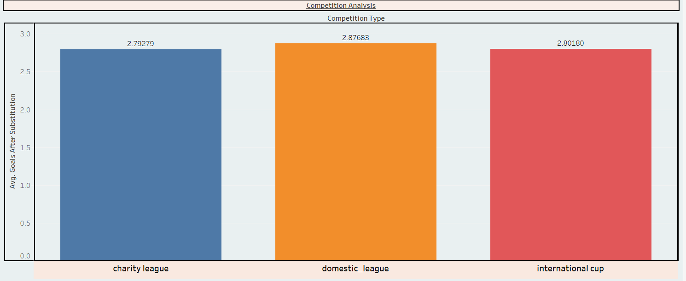
Competition Analysis
What are the impacts creating substitute players from different countries in these competitions?
players from a particular country consistently score more goals or provide more assists, it might indicate higher effectiveness or skill levels among those substitutes.Variations in minutes played could suggest that some substitutes are used more frequently or in more critical situations
Which competition types see the most strategic substitutions in terms of goals scored afterward?
Average of Goals After Substitution for each Competition Type. Color shows details about Competition Type. The marks are labeled by average of Goals After Substitution. The data is filtered on Season, which ranges from 2013 to 2020. The view is filtered on Competition Type, which keeps charity league, domestic_league, international cup and other

Slide 11
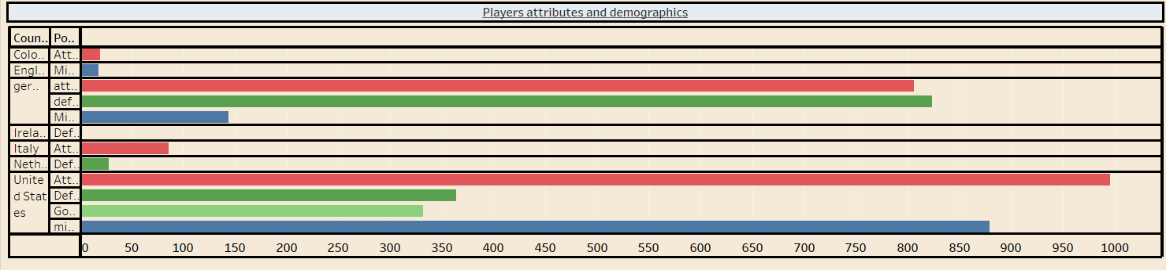
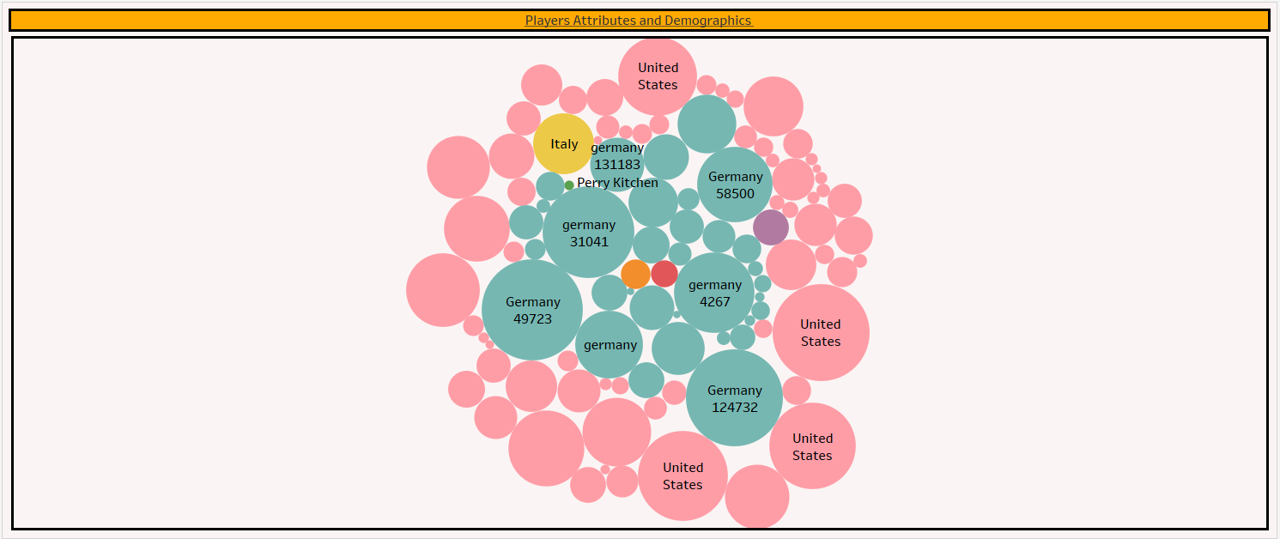
Player Attributes and Demographics
How do a player's demographics influence their on-field performance during a season?
The in-depth analysis of player demographics reveals how various factors like nationality, age, position, height, and dominant foot intricately shape on-field performance. Players from certain countries consistently lead in key metrics such as goals, assists, and overall minutes, highlighting that certain regions may produce talent particularly suited to high-impact roles
Does a player's market value or demographics influence the manager's substitution decisions during matches with significant attendance?
The visualization reveals key insights into how player market value and demographics influence managerial substitution decisions during high-attendance matches. Players with higher market values appear to be substituted more frequently

Slide 12
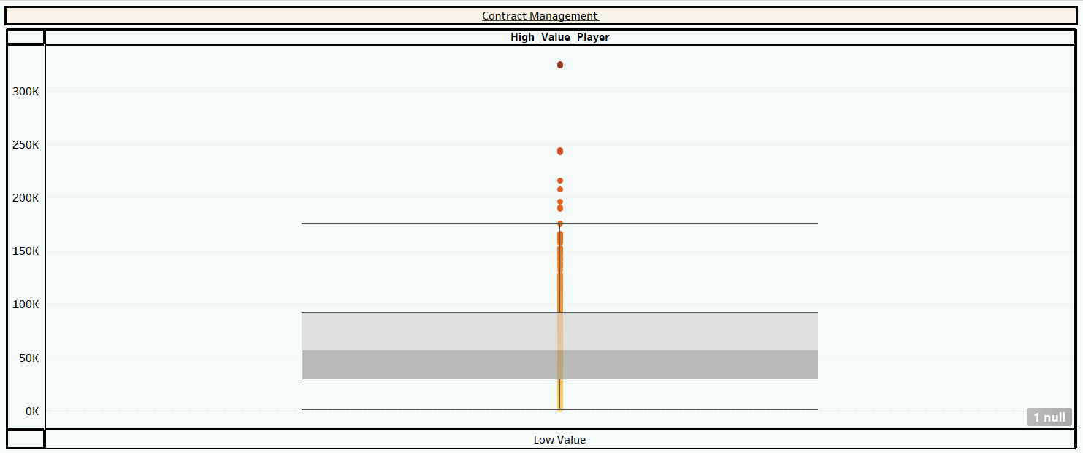
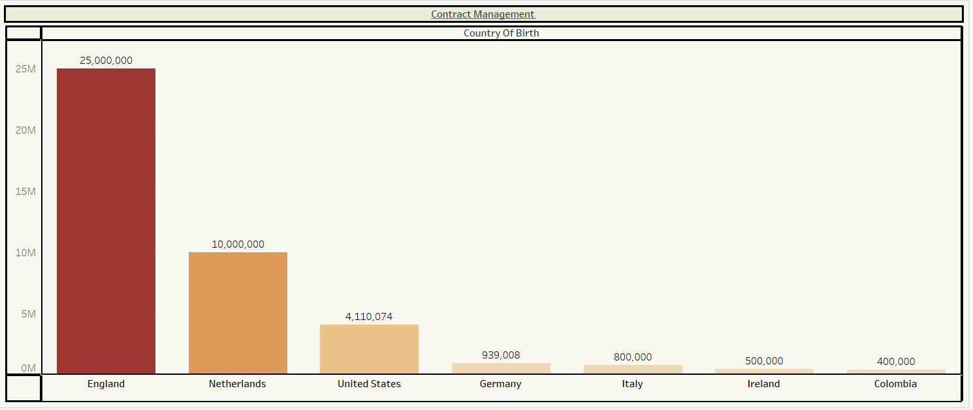
Contract Management
Does the presence of high-value players, based on their contract terms, affect the attendance at games?
The analysis reveals a nuanced picture of how high-value players impact game attendance. If the results show that games featuring high-value players consistently attract larger crowds, it suggests that fans are more drawn to matches where star players are present, potentially enhancing the overall game experience and increasing ticket sales.
Do players from certain countries have higher market values?
The visualization of the average market value of players by country reveals notable disparities in player valuations across different nationalities. Players from countries with strong footballing traditions and high-performance leagues, such as Brazil or France, tend to have higher average market values, reflecting their established reputation and demand in the global football market.

Slide 13
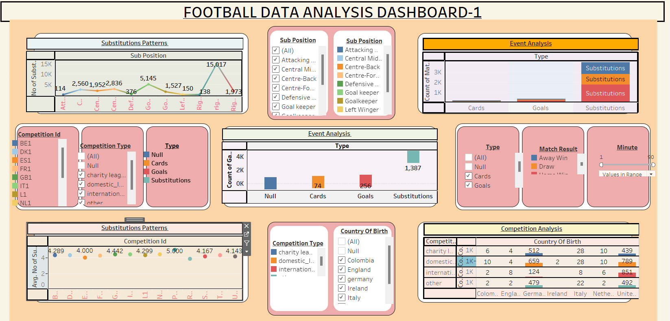
DASHBOARD - 1

Slide 14
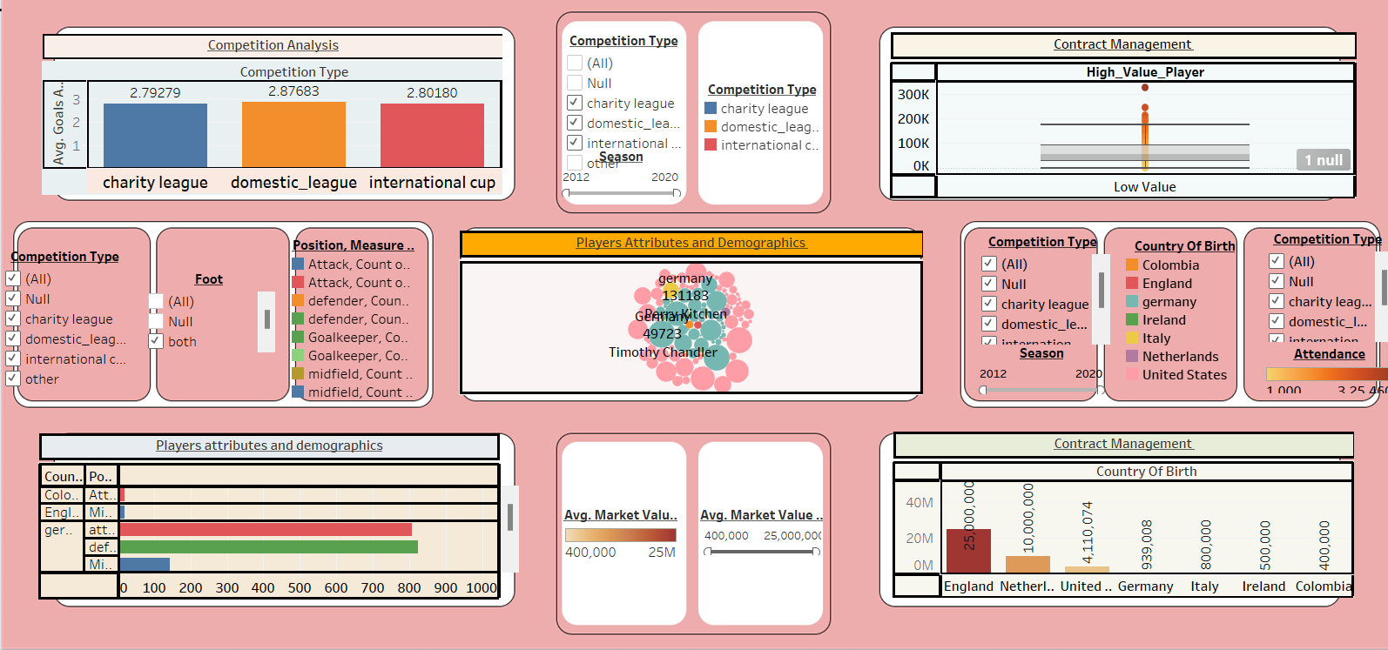
DASHBOARD - 2

Slide 15
SUMMARY
The dynamics of football have changed in recent seasons due to notable performances and interesting trends. With 119 goals, Aron Johannsson is the most deadly scorer in the league, and Christian Pulsic has shown himself to be an important facilitator with 32 assists. The attendance figures at stadiums speak for themselves: Old Trafford had the highest average attendance of 75,112 people, while May 2019 had the highest attendance of 44,731. Referee Dr. Felix Brych ych has officiated 79 games on 1 field, making him the busiest, which shows how important he is to keeping the game moving.
It's interesting to note that during the game, match events like goals and substitutions are dispersed more evenly, with goals peaking at the 60th minute. Player demographics show that age ranges are consistent amongst contests, with most players peaking in their early 30s. Nonetheless, the pandemic's effects are evident because 2020 saw a dramatic drop in objectives and replacements, underscoring the disruption it brought about. Despite this, players' market values continue to be important, especially for younger players in their early 20s who fetch greater fees before starting to decline as they get older.

Slide 16
Football clubs must strategically manage substitutions, player performance metrics, and market values to gain a competitive edge.Frequent substitutions, player versatility, and game events impact match outcomes, while market value tied to player origin and crowd dynamics informs recruitment and fan engagement.
High-value players boost both performance and attendance, highlighting their dual importanceAdditionally, consistent leadership and strategic management based on data-driven insights help clubs optimize tactics, enhance stadium experiences, and make informed decisions, leading to sustained success in a competitive environment.

Slide 17
KEY FINDINGS
Aron Johhansson is the leading goal scorer with 119 goals
Christian Pulisic assists charts with 32 assists
Highest attendance was seen in 2012 – 2019 and declined in 2020
Dr Felix Brych was the lead referee for almost 80 games and is among top referees from analysis
Player age ranges are from 25-35 for the domestic league, domestic cup and international cup
Attackers and midfielders have highest average market value and goalkeepers with low averages comparatively
Home club is generally scored more than the away club from the analysis
Substitution peaked in 2012 and declined at 2020 just like seasonality of the attendance of matches

